Slide 1






Mentorship program
Digital Learning Platform
Khuat Bao Nguyen

Slide 2




Agenda
01
03
Use Case Diagram
Database
02
Mock Up
Mentorship program

Slide 3
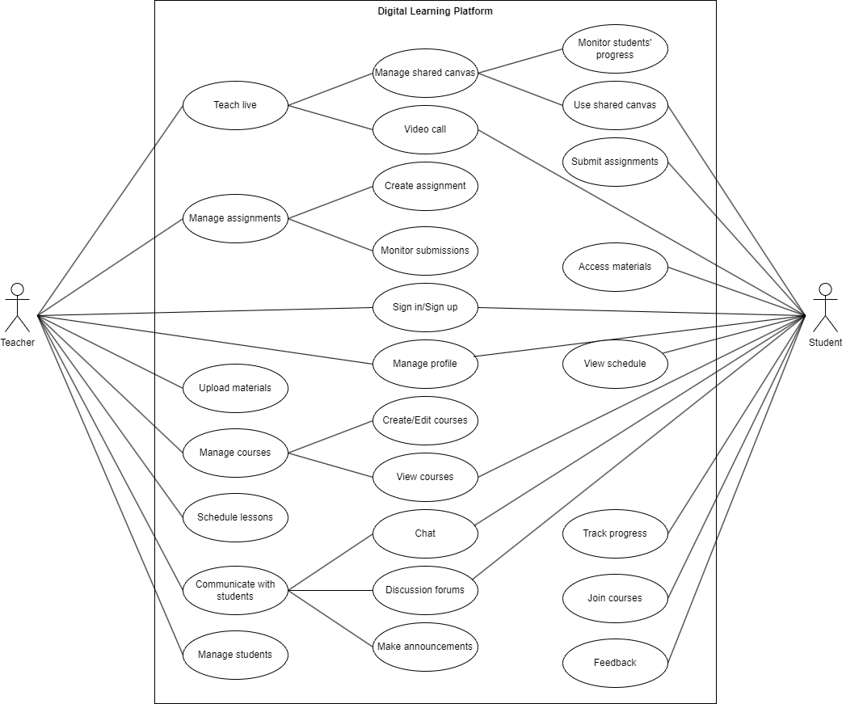
Use
Case Diagram

Slide 4
Mock Up
1
Demo videos
2
Shared features
3
For teachers
4
For students

Slide 5
DEMO VIDEOS

Slide 6
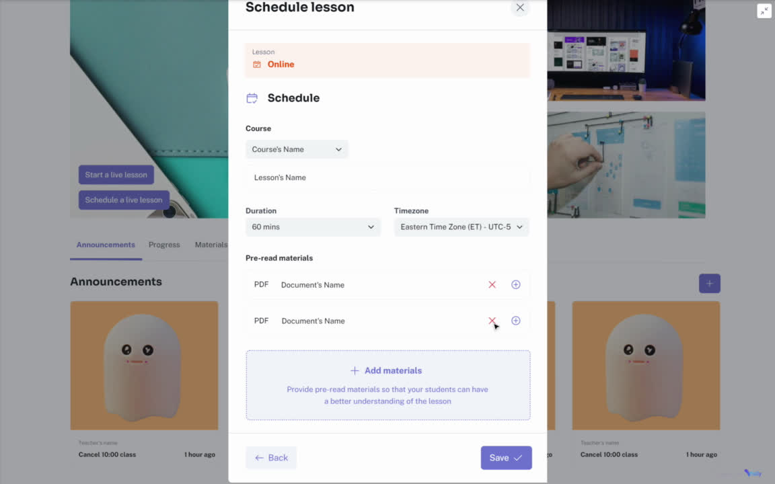
Demo video
for teachers

Slide 7
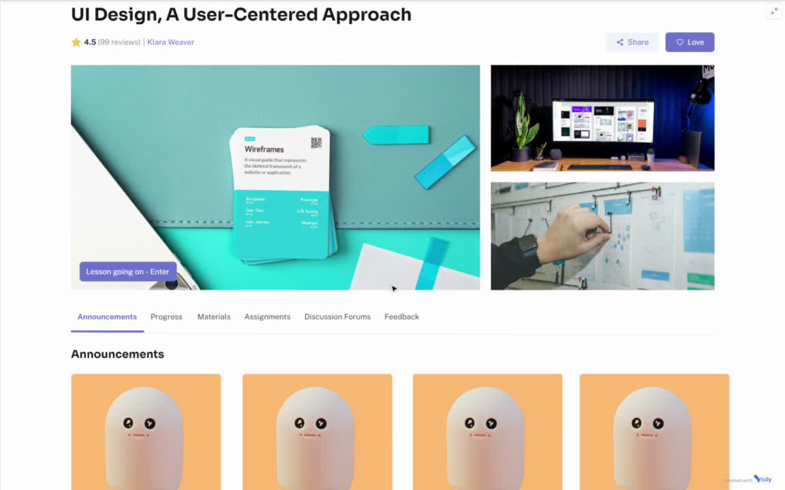
Demo video
for
students

Slide 8
SHARED FEATURES

Slide 9
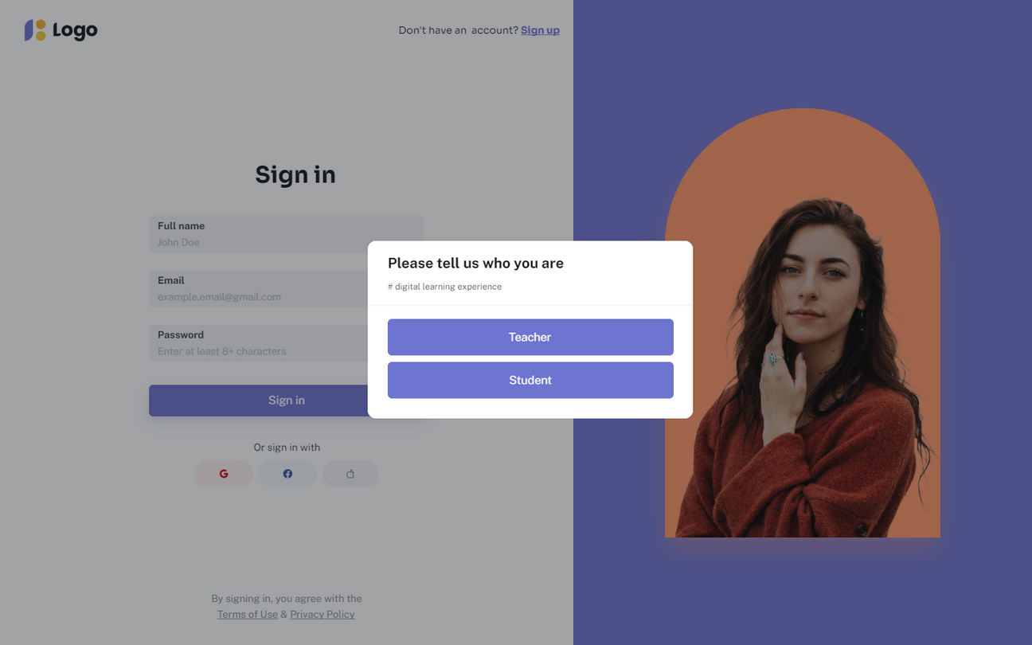
Sign in/ Sign up

Slide 10
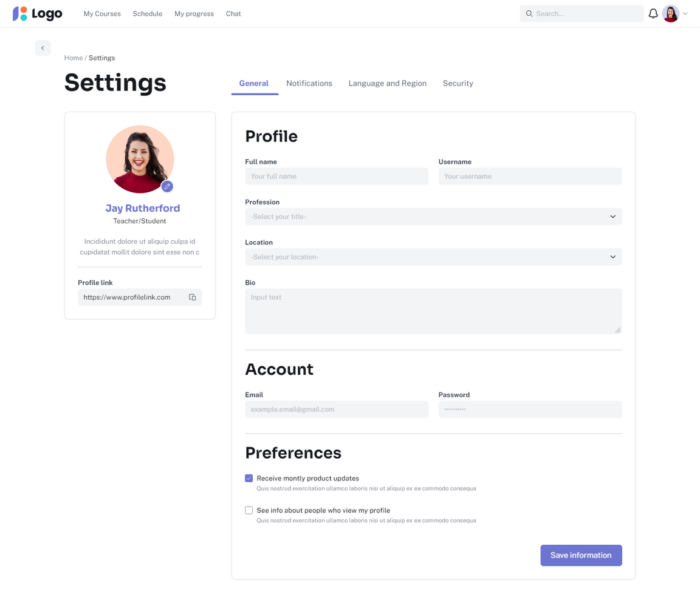
Manage profile

Slide 11
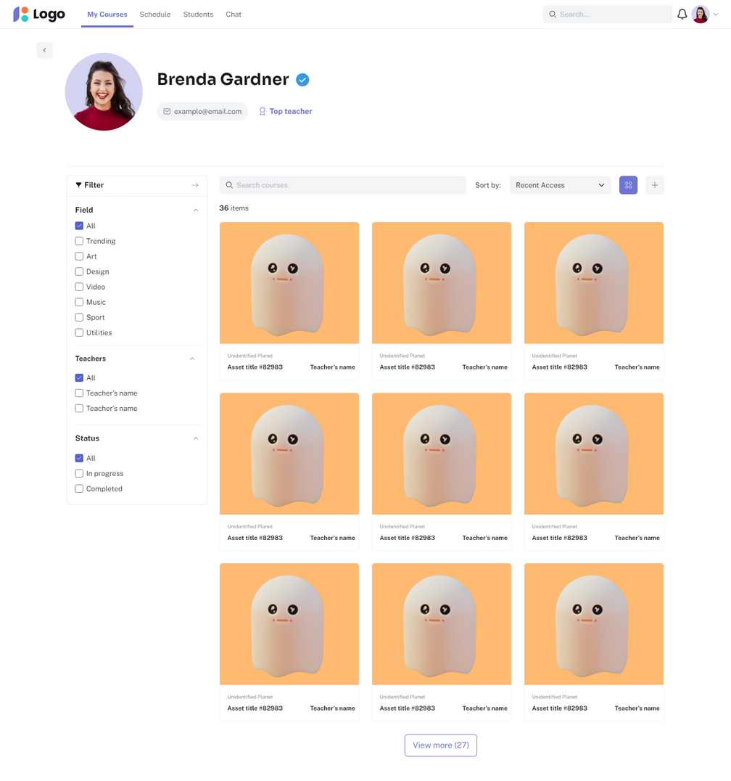
View courses (Courses listing)

Slide 12
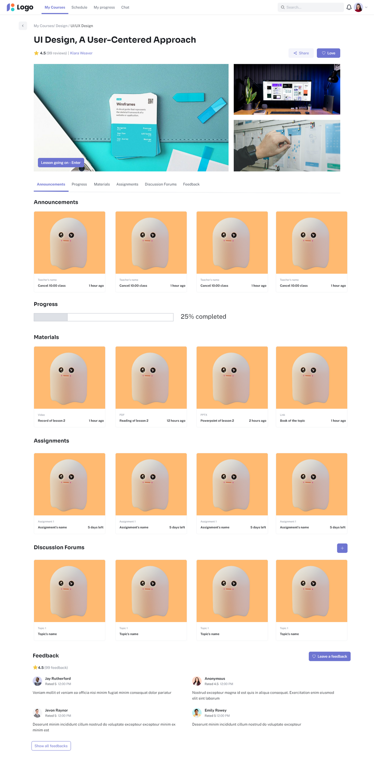
View courses (Course’s details)

Slide 13
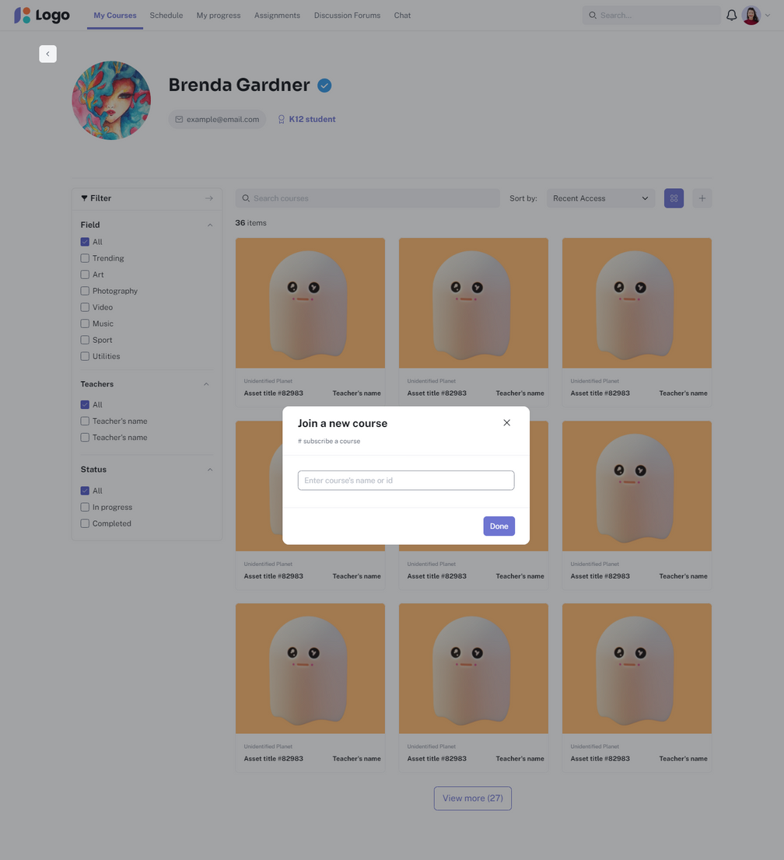
Join courses

Slide 14
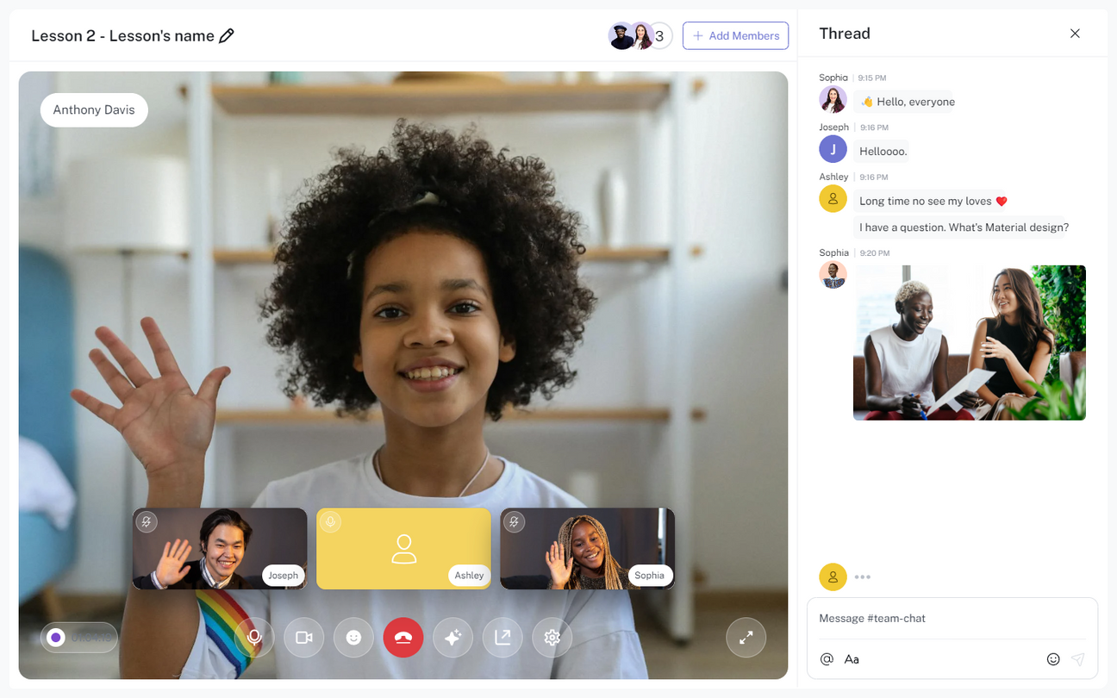
Video call (Attend live lessons)

Slide 15
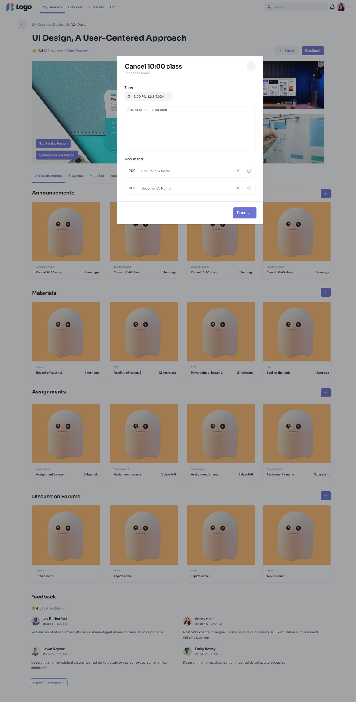
View announcments

Slide 16
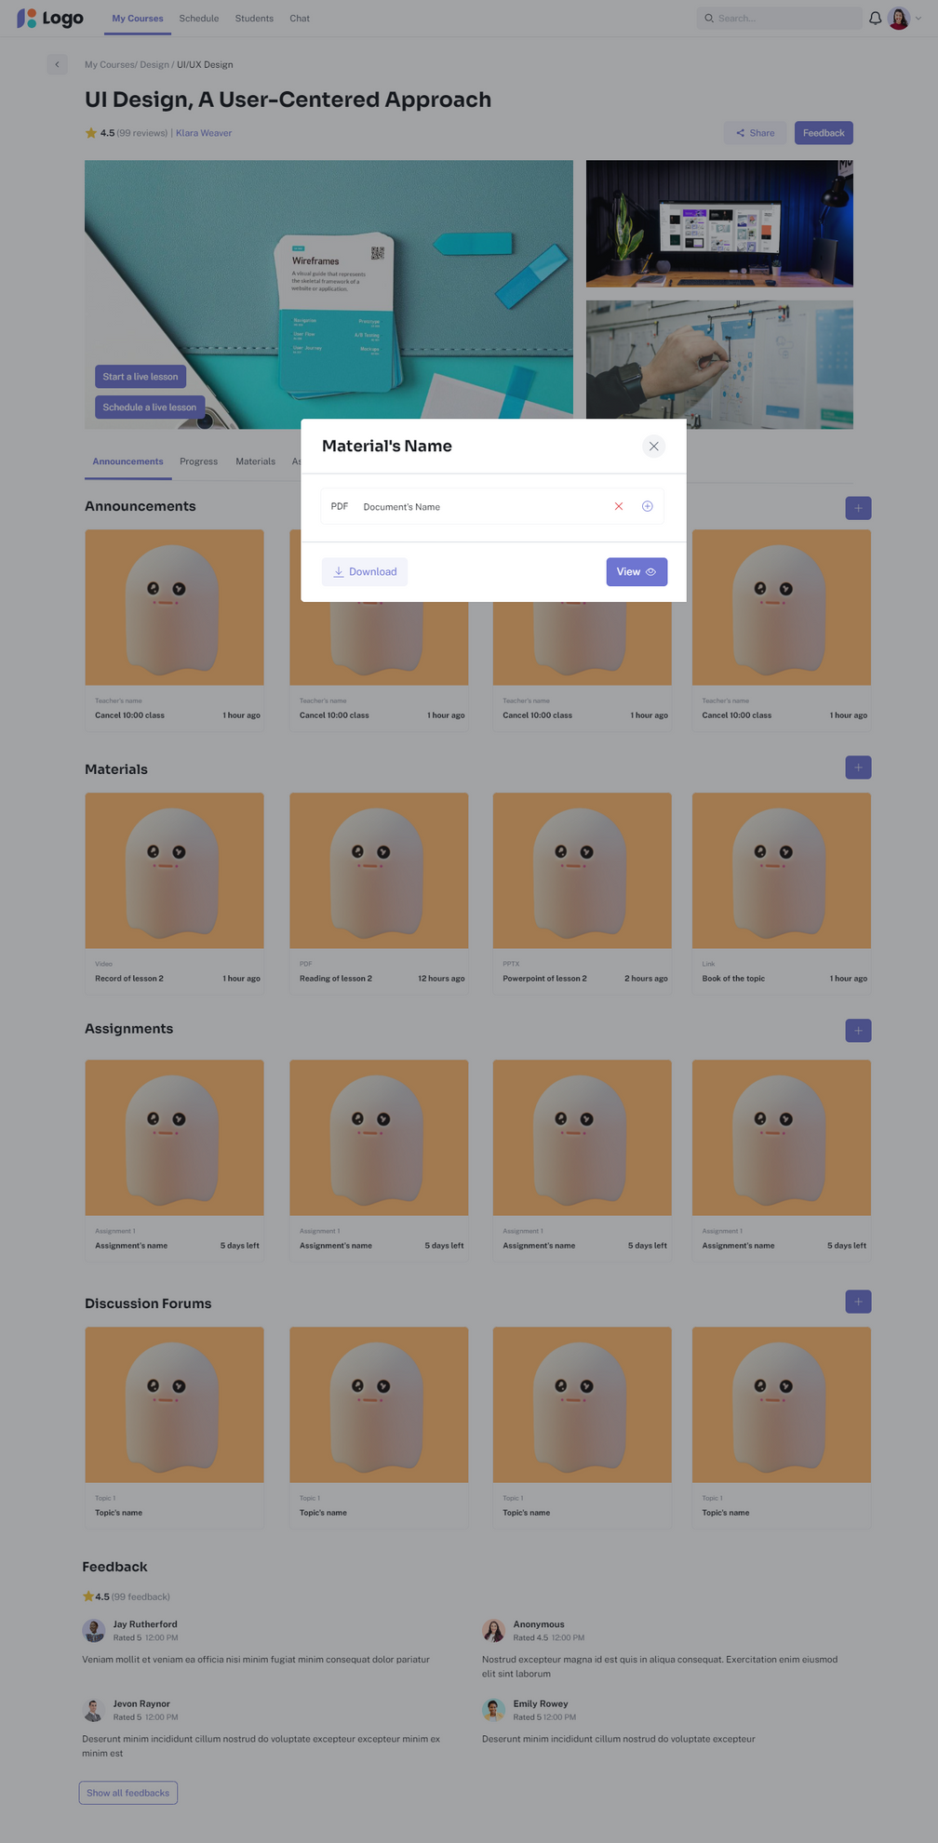
Access materials

Slide 17
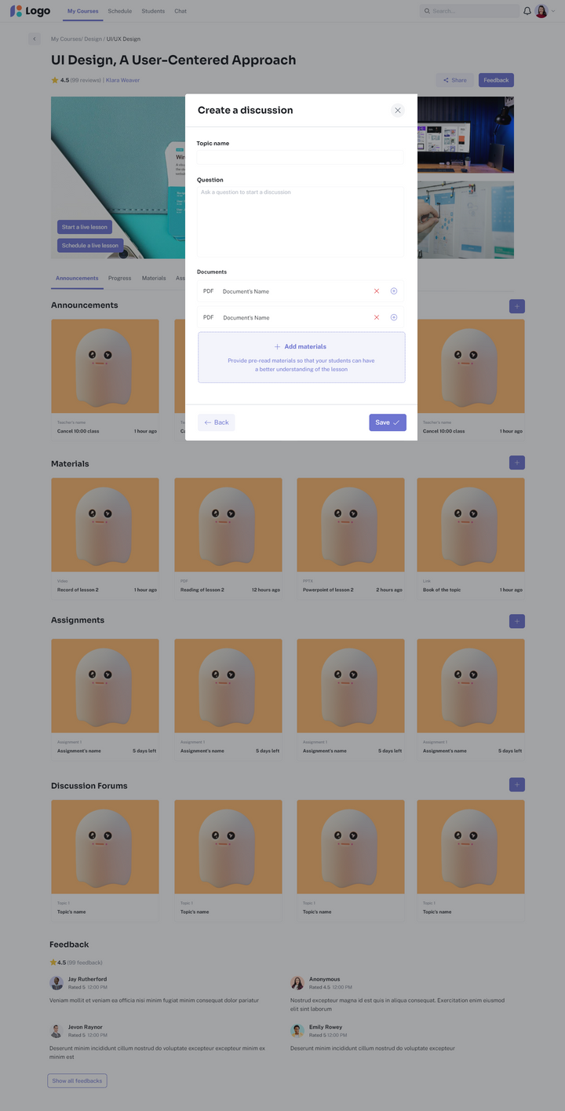
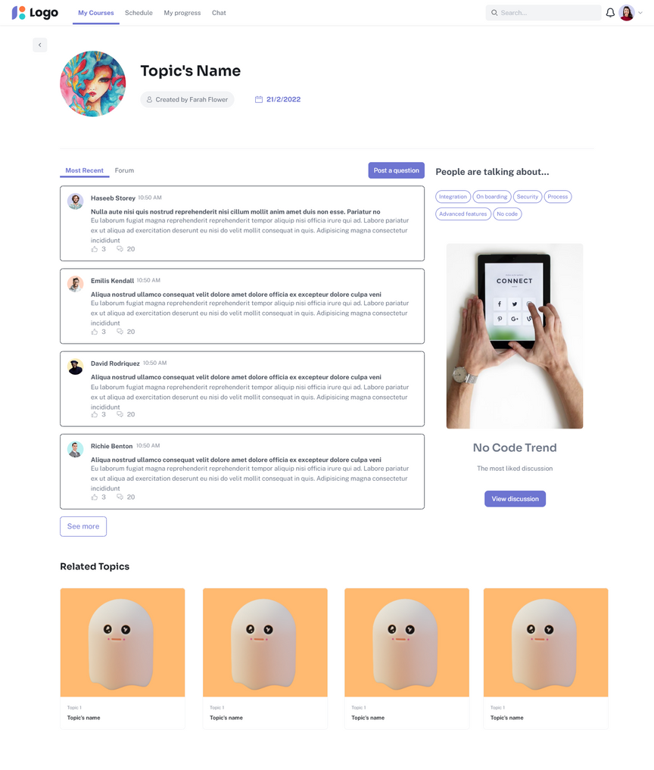
Create and join discussion forums

Slide 18
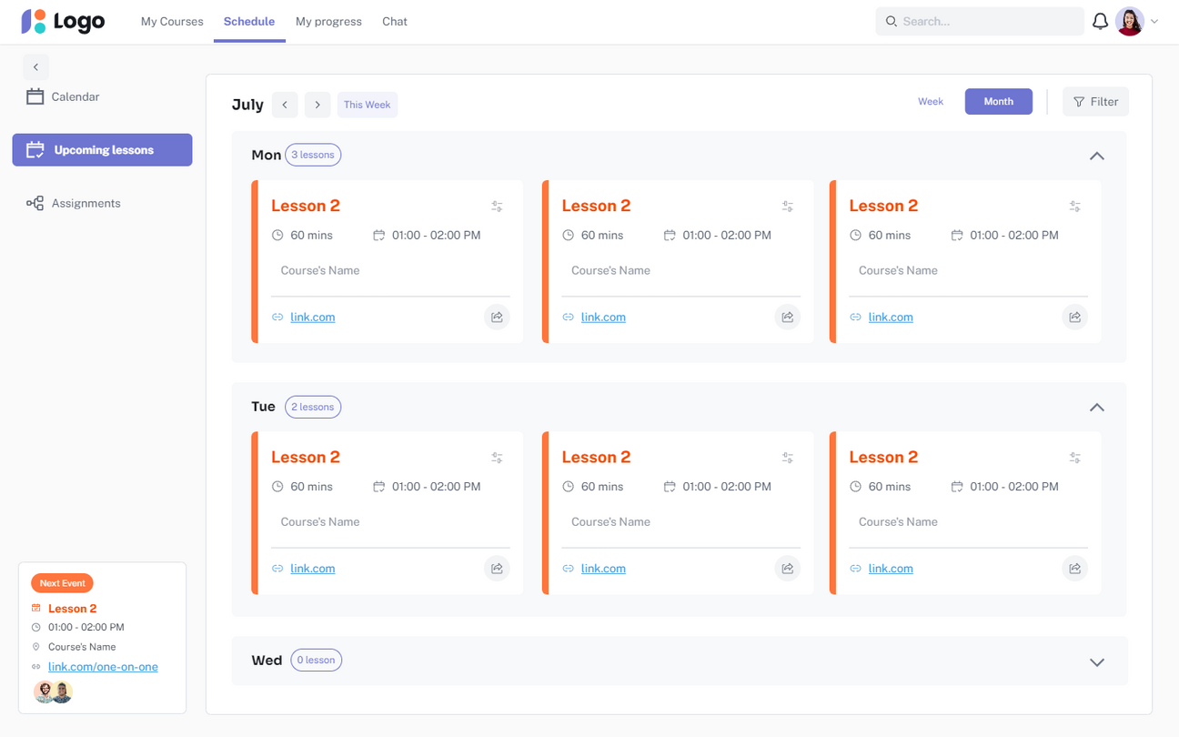
View schedule

Slide 19
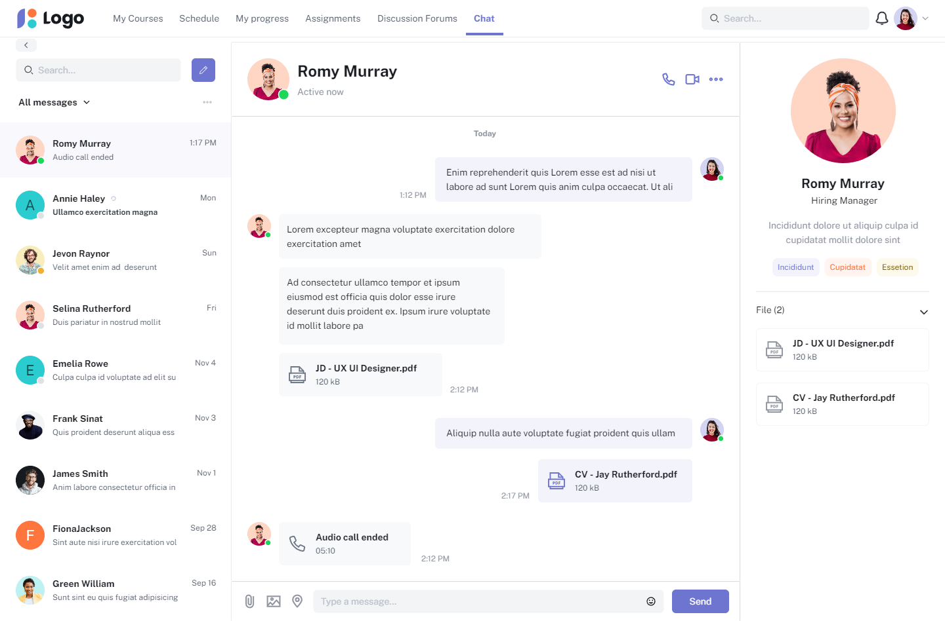
Chat

Slide 20
For Teachers

Slide 21
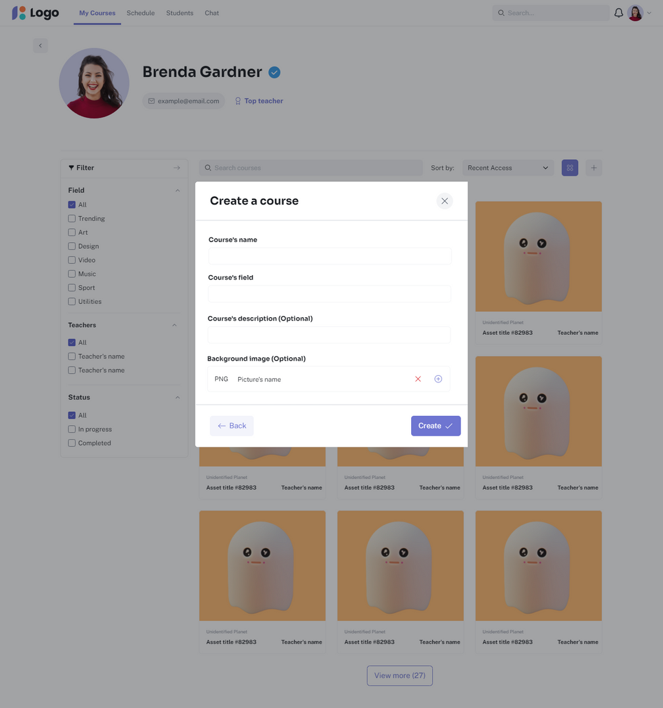
Create new course

Slide 22
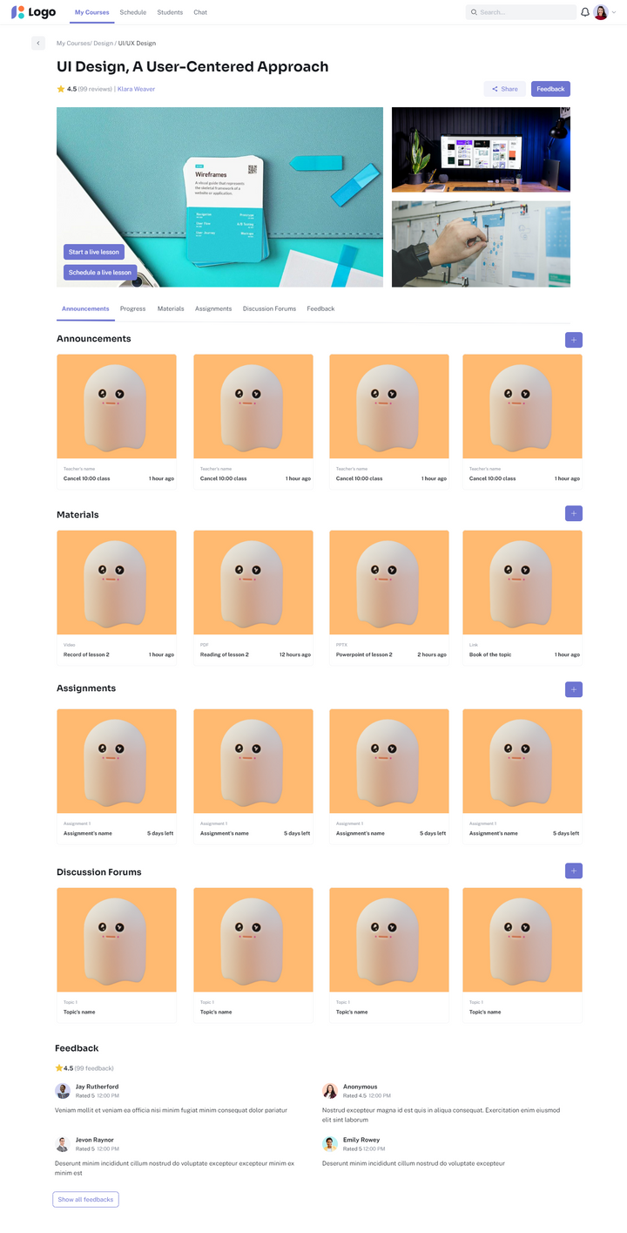
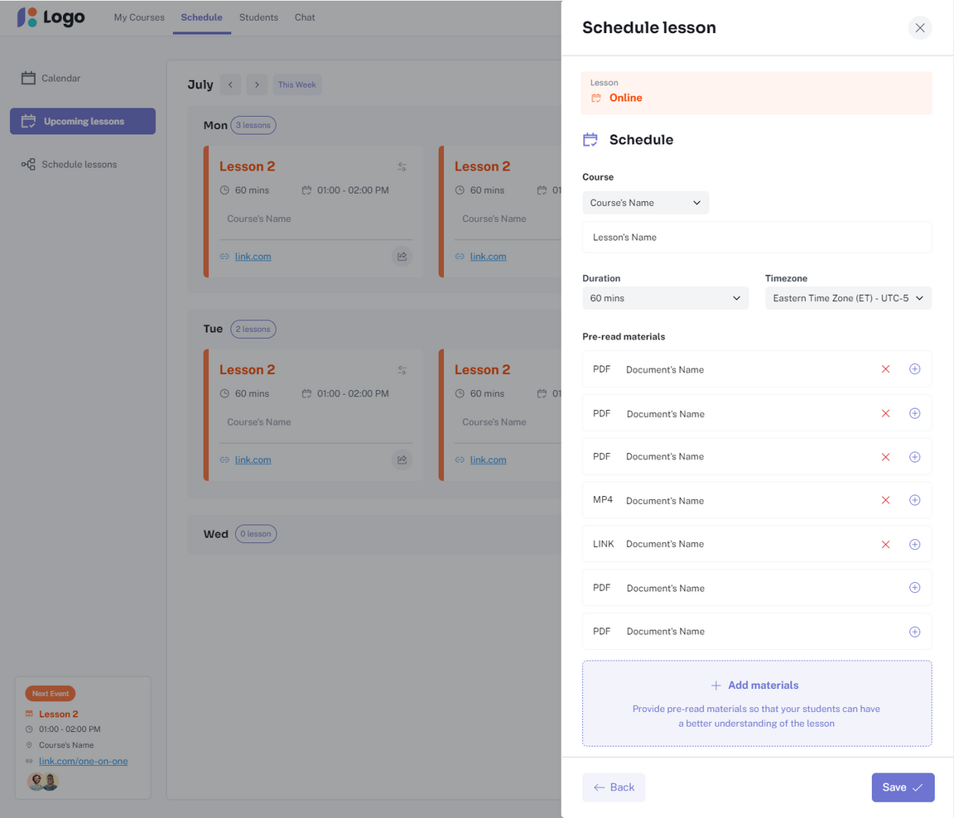
Start lesson + Schedule lesson

Slide 23
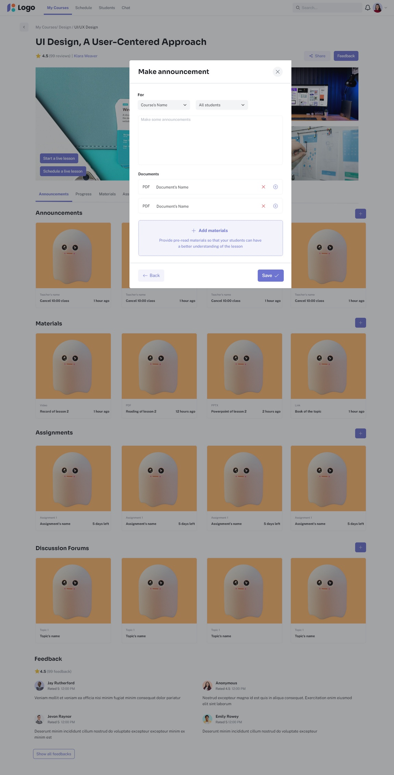
Make announcments

Slide 24
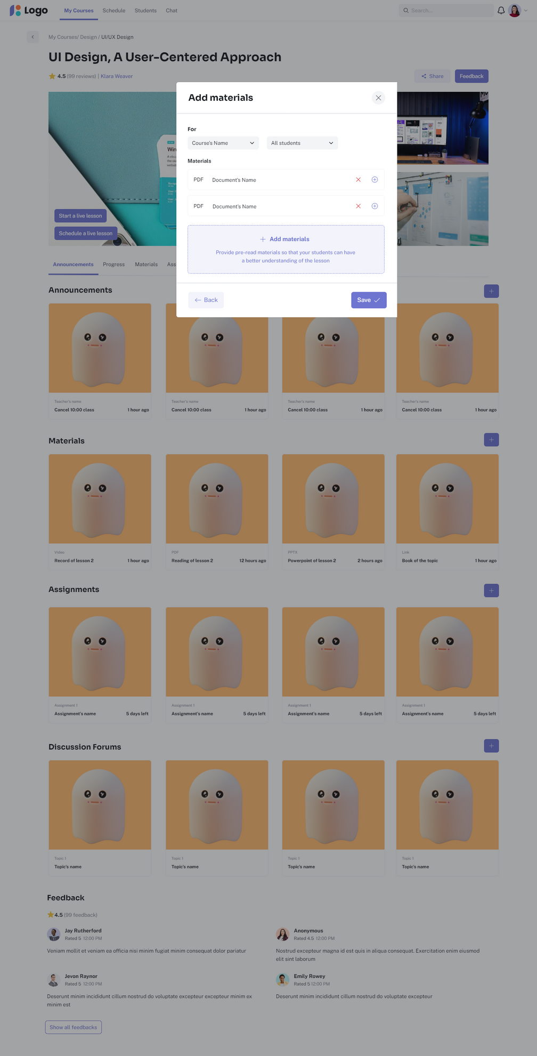
Upload materials

Slide 25

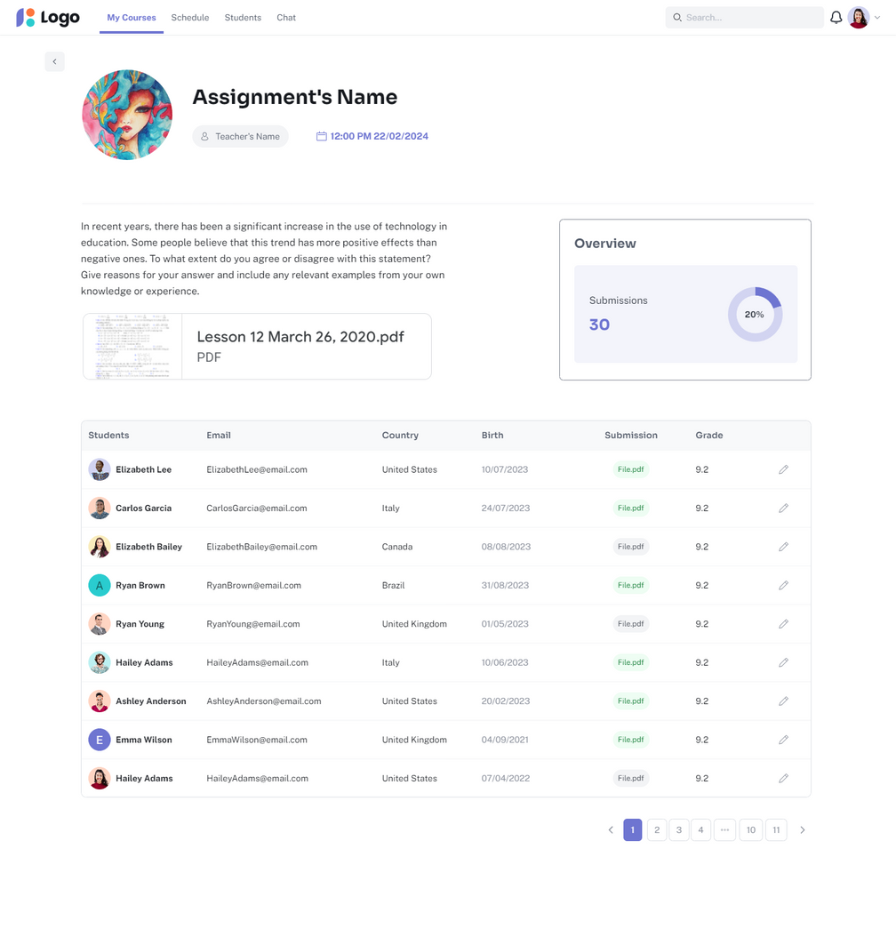
Add assignments + Monitor submissions

Slide 26
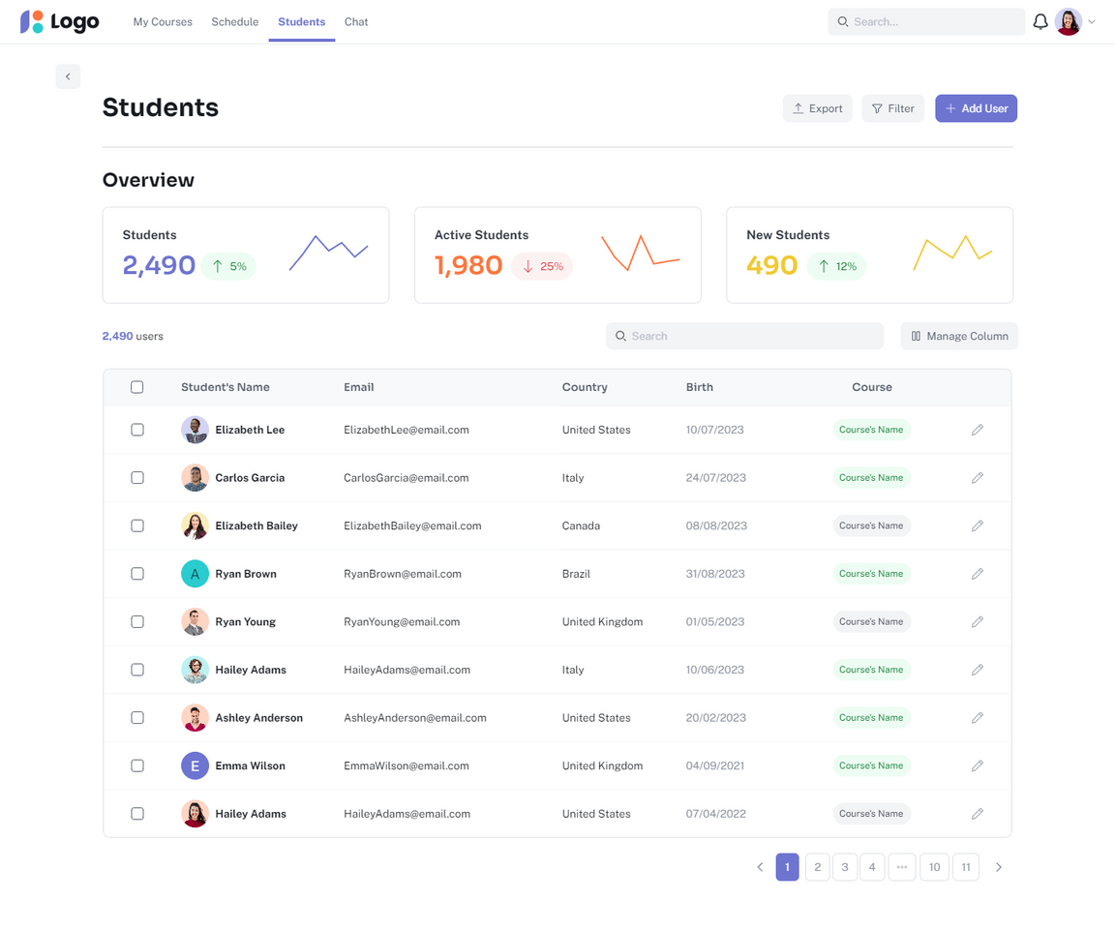
Manage students

Slide 27
For Students

Slide 28
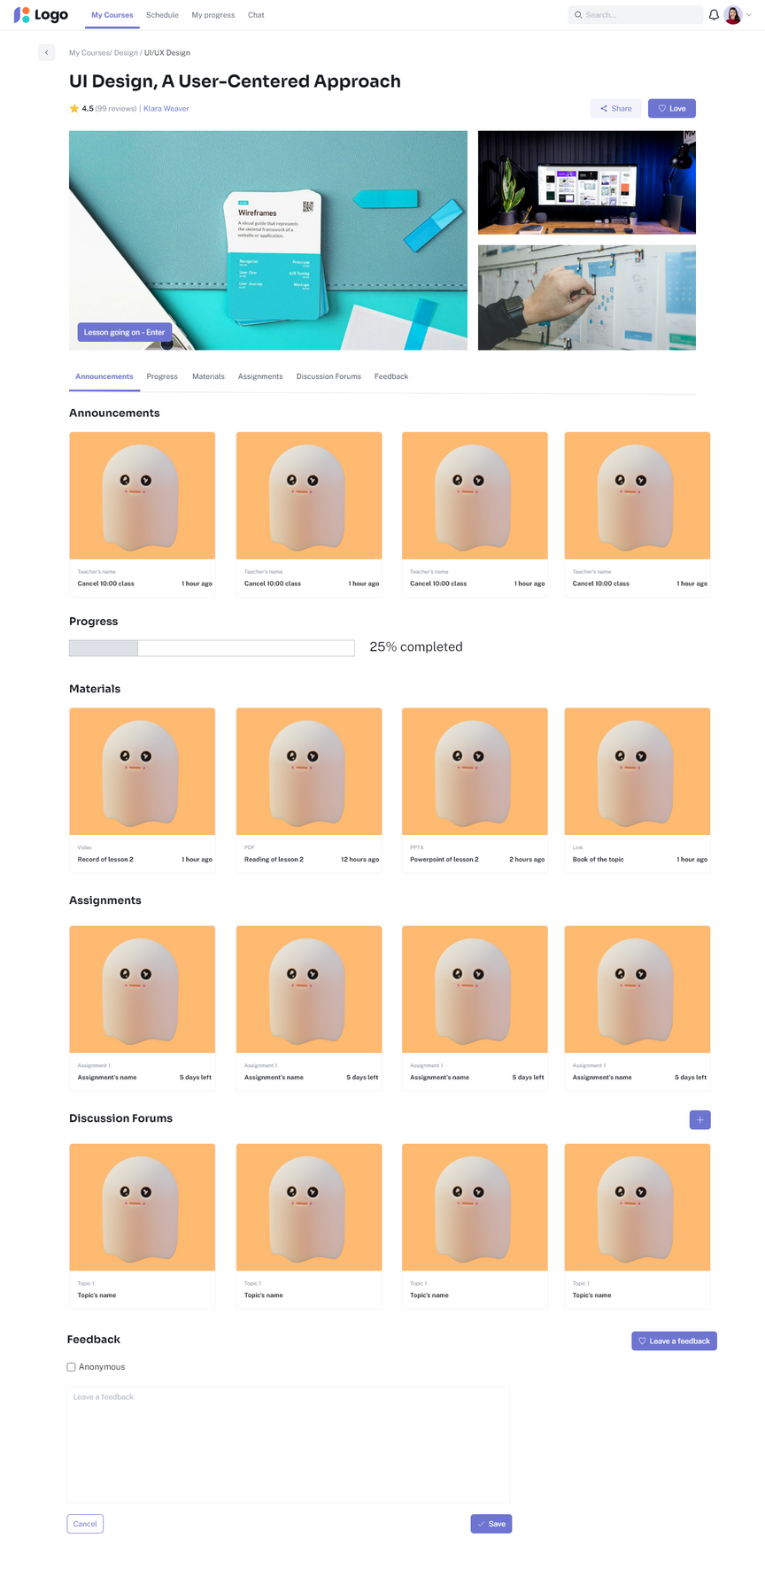
Feedback

Slide 29
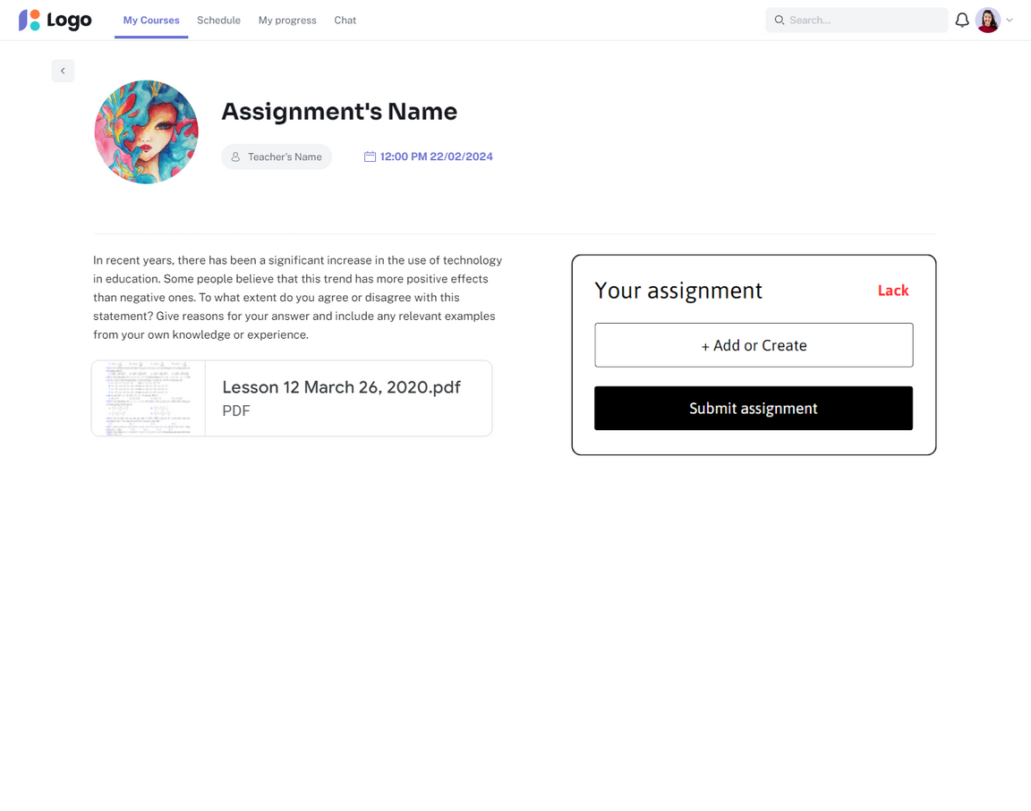
Submit assignments

Slide 30
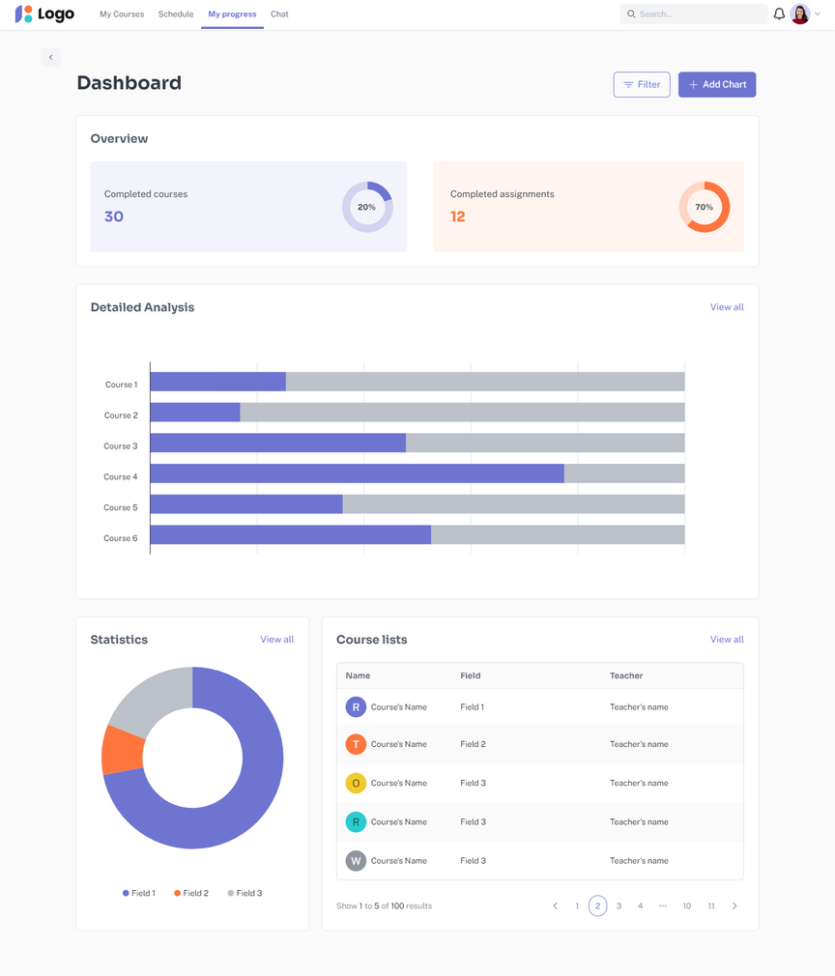
Track progress

Slide 31
Database
1
Overview
2
Detailed Explanation

Slide 32
Overview

Slide 33
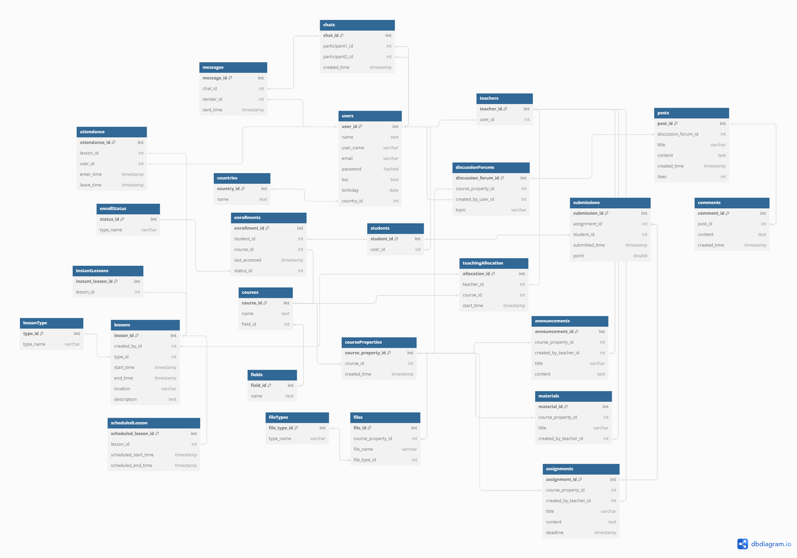

Slide 34
Detailed Explanation

Slide 35
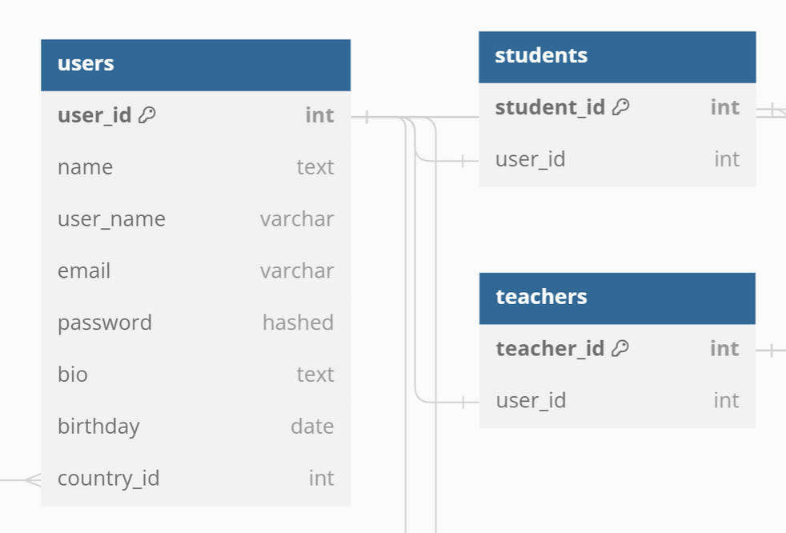
Users + Students + Teachers

Slide 36
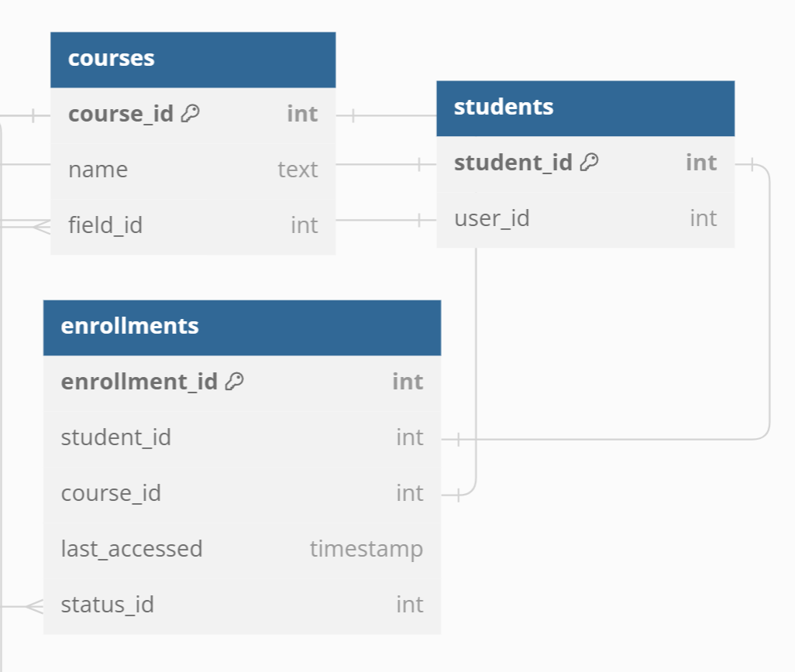
Students + Courses + Enrollments

Slide 37
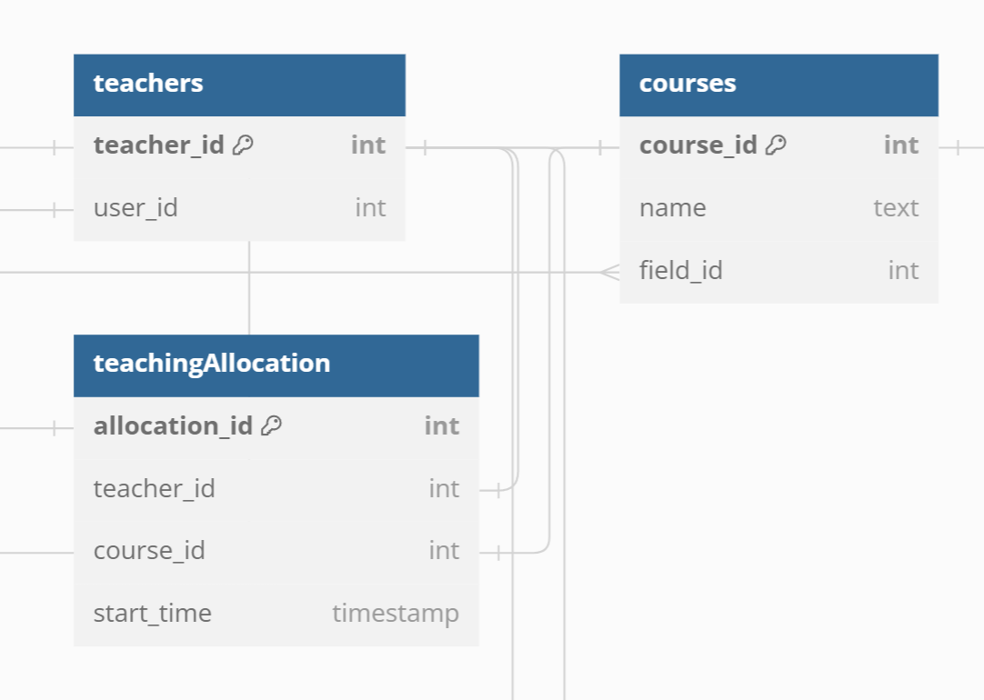
Teachers + Courses + teachingAllocations

Slide 38
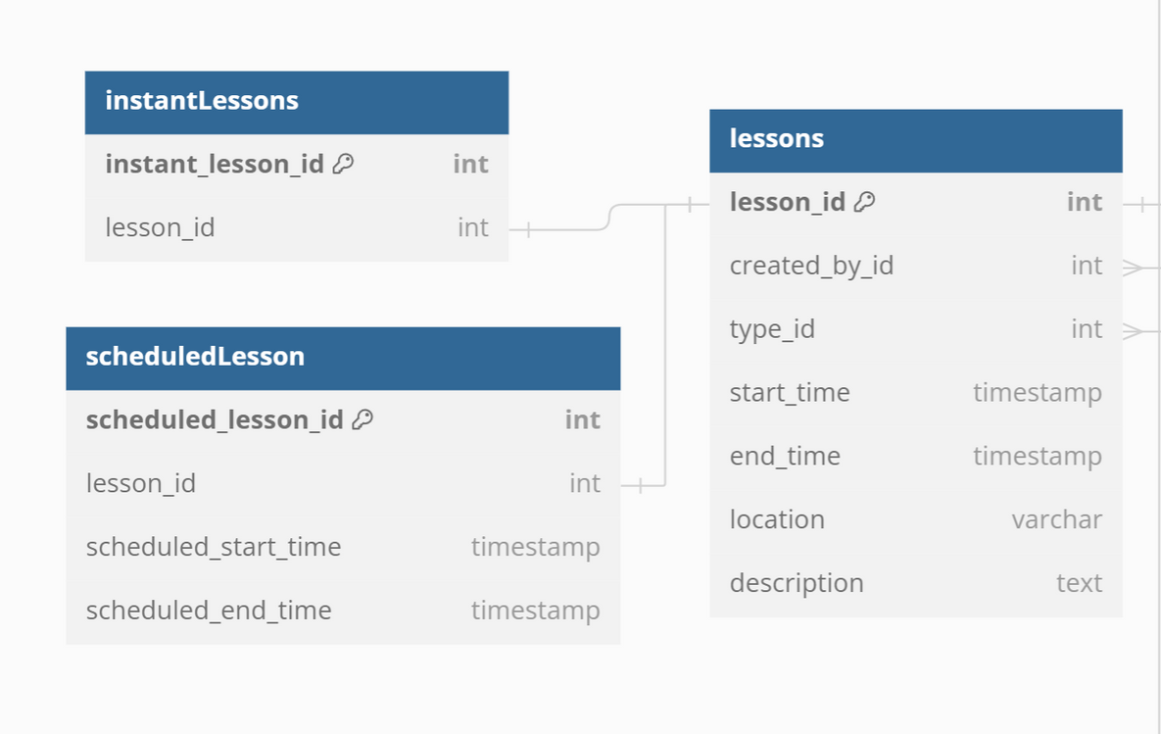
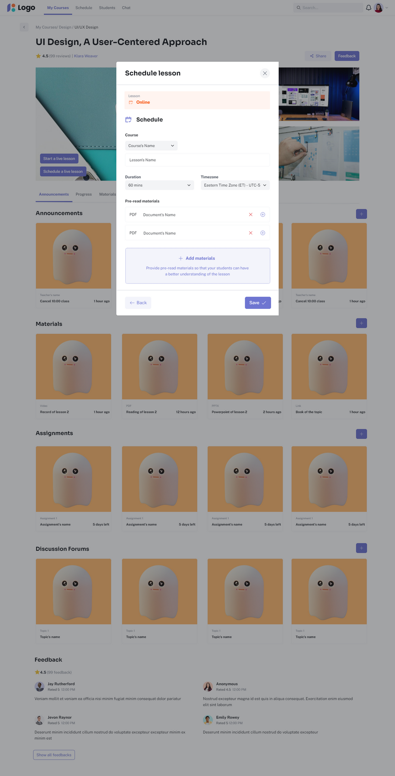
Lessons + instantLessons + scheduledLesson

Slide 39
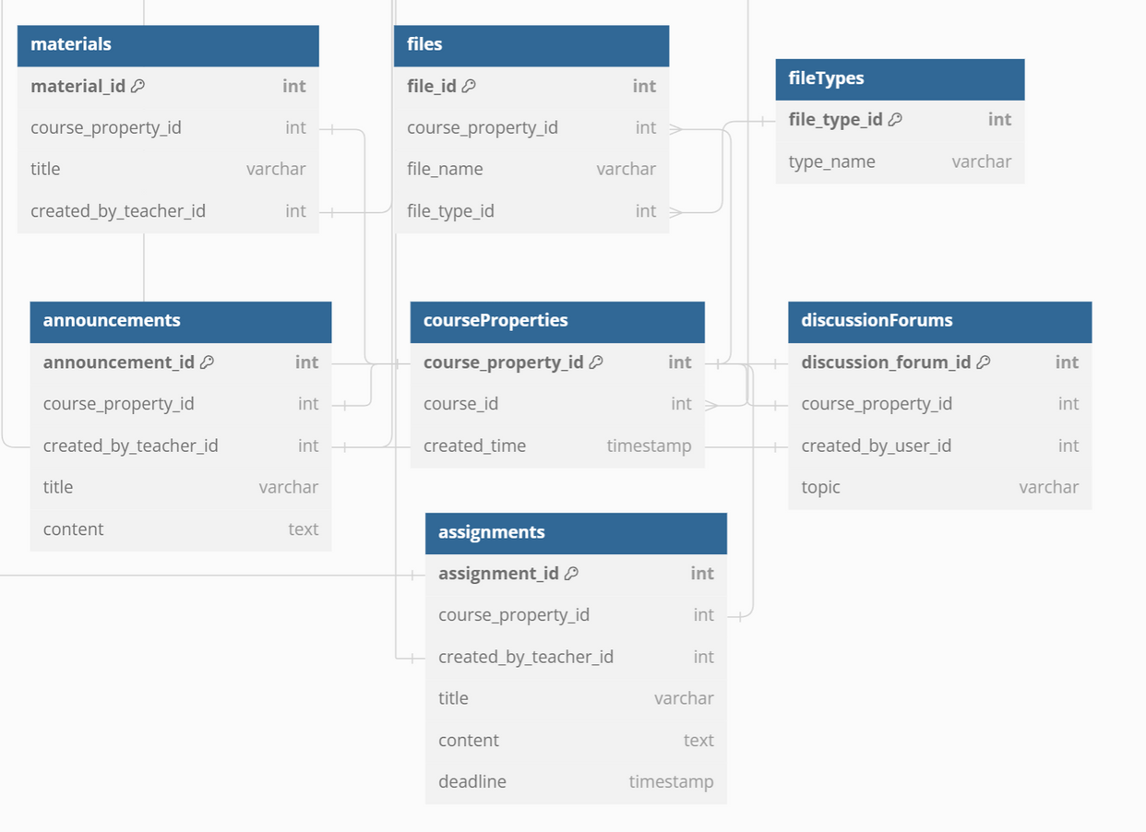
CourseProperties + Files

Slide 40
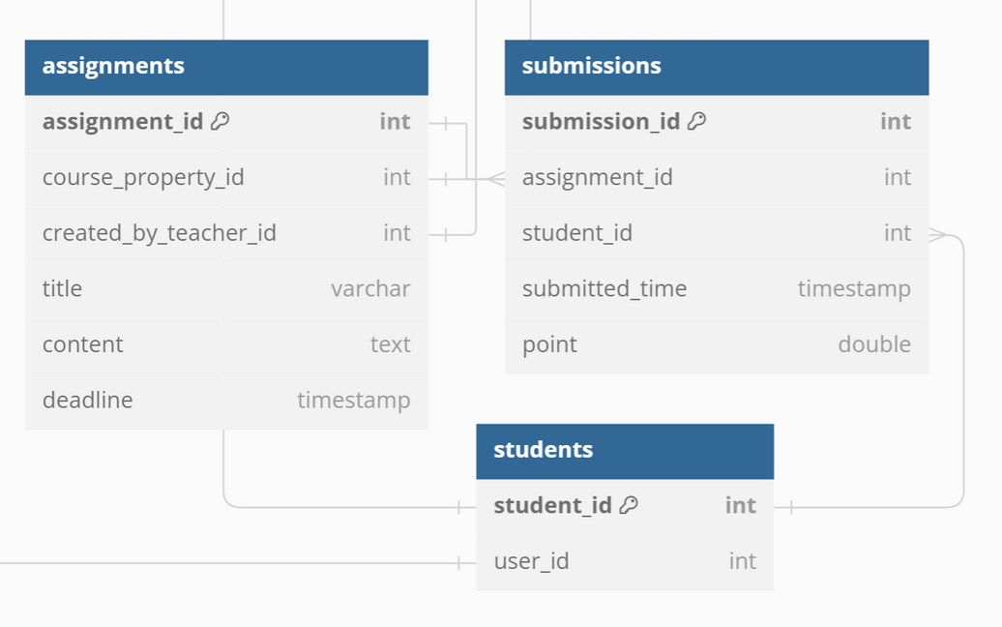
Assignments + Submissions + Students

Slide 41
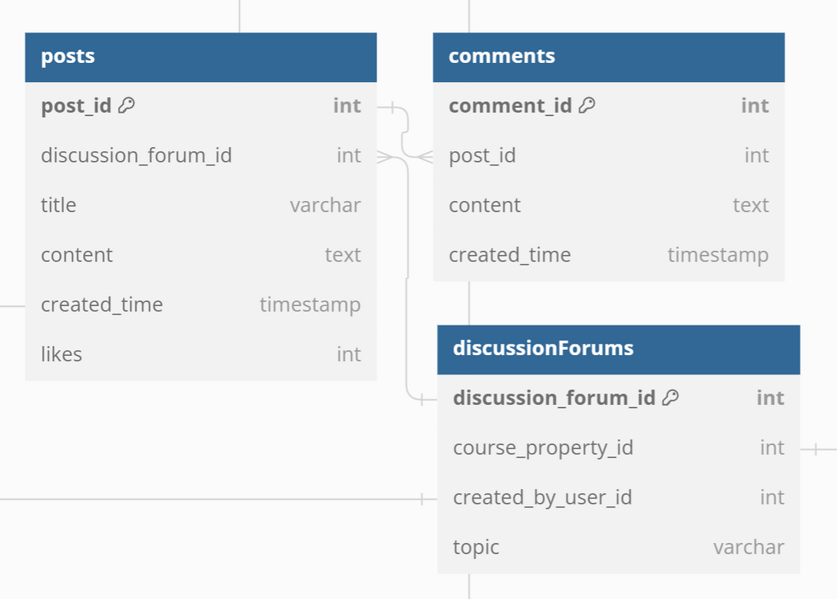
DiscussionForums + Posts + Comments

Slide 42
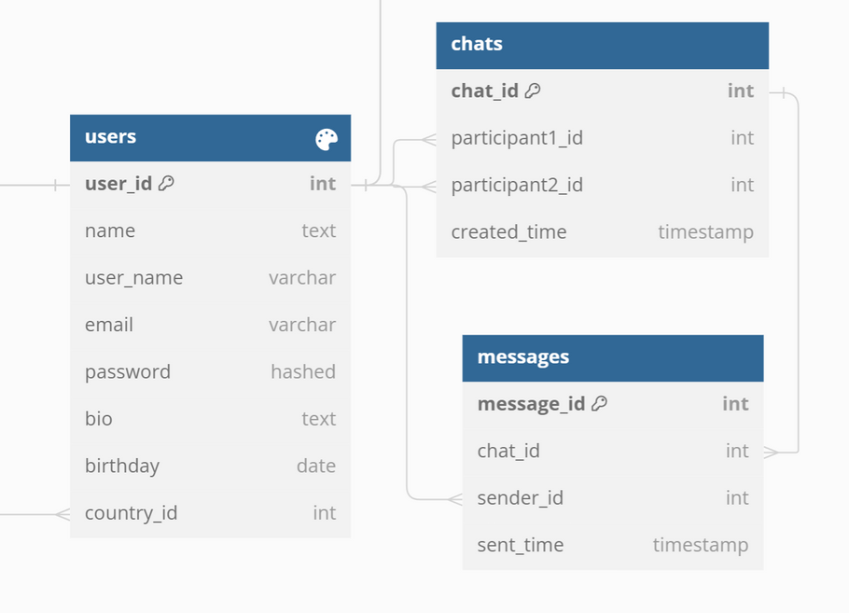
Chat + Messages + Users

Slide 43


Thank you
I really appreciate your time.
Khuat Bao Nguyen

